Slide 1
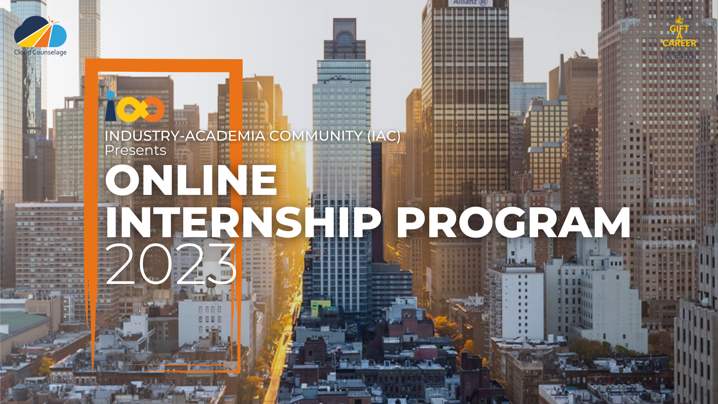
Please delete the sheet before submitting

Slide 2


Using The WORK BREAKDOWN STRUCTURE Sheet
Before submitting the file, please rename the file as ‘IAC IP23 – WBS – Your Domain Name – Your full name’
The Work Breakdown Structure (WBS) provided is just a guideline, you are allowed to modify the same based on your problem statement
Given the timeline and deliverables the WBS is based on Waterfall Methodology
Add tasks wherever required based on your problem statement
Follow the below colours for Project hierarchy
Please delete the sheet before submitting
Project Goal
Phases
Stages
Activities/
Deliverables
Tasks

Slide 3
WORK BREAKDOWN STRUCTURE – IP23 Live Project Deliverables – ‘Data Analytics’
Create a
‘DATA VISUALIZATION’
as per Industry Ways of Working
INITIATION
Project Charter
SRS Document
PLANNING
WBS
Project Schedule
RAID Logs
EXECUTION & MONITORING
Lessons Learnt, Project Report
Visualization files
Video
CLOSURE
Study Data
Clean Data
Import Data
Analyse & Create Visualization
Notes:
Project Objective at the Top, then dependencies (Activities) and sub dependencies (Tasks) Activities:
Tasks: WBS name: Website design
Description: Revamp our old website design based on the new branding.
Completion date: 9/15/21
Budget: $50,000
Level 1:
Revamp website design
Level 2:
Revamp brand guidelines (Complete)
Create messaging framework (Complete)
Redesign logo (In progress)
Add new photography (Open)
Level 3:
1. Revamp brand guidelines
Brand colors—Kat Mooney
Brand mood board—Kat Mooney
Design UX—Ray Brooks
2. Create messaging framework
Headline—Daniela Vargas
Mission statement—Daniela Vargas
Language guidelines—Daniela Vargas
3. Redesign logo
Sketch—Kabir Madan
Mockups—Kat Mooney
Final designs—Kat Mooney
4. Add new photography
Photoshoot—Kabir Madan
Photo edits—Kat Mooney
Final selections—Kabir Madan

Slide 4
WORK BREAKDOWN STRUCTURE – IP23 Live Project Deliverables – ‘MANAGEMENT’
Create a
‘BUSINESS PROCESS’
as per Industry Ways of Working
INITIATION
Project Charter
Scope Document
PLANNING
WBS
Project Schedule
RAID Logs
EXECUTION & MONITORING
Lessons Learnt, Project Report
Process Map
Presentation Video
CLOSURE
Templates
Understand 'As - Is' Process
Identify Gaps
Research
Create 'To-Be' Process
Notes:
Project Objective at the Top, then dependencies (Activities) and sub dependencies (Tasks) Activities:
Tasks: WBS name: Website design
Description: Revamp our old website design based on the new branding.
Completion date: 9/15/21
Budget: $50,000
Level 1:
Revamp website design
Level 2:
Revamp brand guidelines (Complete)
Create messaging framework (Complete)
Redesign logo (In progress)
Add new photography (Open)
Level 3:
1. Revamp brand guidelines
Brand colors—Kat Mooney
Brand mood board—Kat Mooney
Design UX—Ray Brooks
2. Create messaging framework
Headline—Daniela Vargas
Mission statement—Daniela Vargas
Language guidelines—Daniela Vargas
3. Redesign logo
Sketch—Kabir Madan
Mockups—Kat Mooney
Final designs—Kat Mooney
4. Add new photography
Photoshoot—Kabir Madan
Photo edits—Kat Mooney
Final selections—Kabir Madan

Slide 5
Project Goal
The goal of this project is to analyze student data from Cloud Counselage to uncover insights related to academic performance, skill development, and career prospects. By leveraging data visualization and statistical analysis, we aim to:
Identify trends in graduation years, course completion, and Python programming experience.
Examine the relationship between GPA, family income, and expected salary.
Detect outliers in course completion and other key metrics.
Compare average GPA across different colleges and cities.
Analyze the impact of leadership skills on GPA and expected salary.
Provide actionable insights through data-driven visualizations to assist in decision-making.
This project is executed using Python, Pandas, Matplotlib, and Seaborn in Jupyter Notebook, ensuring a comprehensive and clear representation of student data trends.
Notes:
Project Objective at the Top, then dependencies (Activities) and sub dependencies (Tasks) Activities:
Tasks: WBS name: Website design
Description: Revamp our old website design based on the new branding.
Completion date: 9/15/21
Budget: $50,000
Level 1:
Revamp website design
Level 2:
Revamp brand guidelines (Complete)
Create messaging framework (Complete)
Redesign logo (In progress)
Add new photography (Open)
Level 3:
1. Revamp brand guidelines
Brand colors—Kat Mooney
Brand mood board—Kat Mooney
Design UX—Ray Brooks
2. Create messaging framework
Headline—Daniela Vargas
Mission statement—Daniela Vargas
Language guidelines—Daniela Vargas
3. Redesign logo
Sketch—Kabir Madan
Mockups—Kat Mooney
Final designs—Kat Mooney
4. Add new photography
Photoshoot—Kabir Madan
Photo edits—Kat Mooney
Final selections—Kabir Madan

Slide 6
Project Phases:
Cloud Counselage Analysis
Data Preprocessing – Load, clean, and convert data types for analysis.
Exploratory Data Analysis (EDA) – Identify unique students, compute statistics, and visualize distributions.
Data Visualization & Insights – Analyze GPA, family income, Python experience, and expected salary trends.
Moderate-Level Analysis – Examine city-wise student distribution, salary variations, and graduation timelines.
Conclusion & Reporting – Summarize insights, document findings, and provide actionable recommendations.
Notes:
Project Objective at the Top, then dependencies (Activities) and sub dependencies (Tasks) Activities:
Tasks: WBS name: Website design
Description: Revamp our old website design based on the new branding.
Completion date: 9/15/21
Budget: $50,000
Level 1:
Revamp website design
Level 2:
Revamp brand guidelines (Complete)
Create messaging framework (Complete)
Redesign logo (In progress)
Add new photography (Open)
Level 3:
1. Revamp brand guidelines
Brand colors—Kat Mooney
Brand mood board—Kat Mooney
Design UX—Ray Brooks
2. Create messaging framework
Headline—Daniela Vargas
Mission statement—Daniela Vargas
Language guidelines—Daniela Vargas
3. Redesign logo
Sketch—Kabir Madan
Mockups—Kat Mooney
Final designs—Kat Mooney
4. Add new photography
Photoshoot—Kabir Madan
Photo edits—Kat Mooney
Final selections—Kabir Madan

Slide 7
Project Stages
Cloud Counselage Analysis
Understanding the Problem Statement – Define objectives and key metrics for analysis.
Data Collection & Cleaning – Load dataset, handle missing values, and format data types.
Exploratory Data Analysis (EDA) – Generate statistical summaries and visualize trends.
Data Interpretation & Insights – Identify patterns, relationships, and outliers in student data.
Advanced Analysis & Visualizations – Perform deeper analysis on factors like GPA, Python experience, and leadership impact.
Findings & Documentation – Compile insights, create reports, and summarize key takeaways.
Notes:
Project Objective at the Top, then dependencies (Activities) and sub dependencies (Tasks) Activities:
Tasks: WBS name: Website design
Description: Revamp our old website design based on the new branding.
Completion date: 9/15/21
Budget: $50,000
Level 1:
Revamp website design
Level 2:
Revamp brand guidelines (Complete)
Create messaging framework (Complete)
Redesign logo (In progress)
Add new photography (Open)
Level 3:
1. Revamp brand guidelines
Brand colors—Kat Mooney
Brand mood board—Kat Mooney
Design UX—Ray Brooks
2. Create messaging framework
Headline—Daniela Vargas
Mission statement—Daniela Vargas
Language guidelines—Daniela Vargas
3. Redesign logo
Sketch—Kabir Madan
Mockups—Kat Mooney
Final designs—Kat Mooney
4. Add new photography
Photoshoot—Kabir Madan
Photo edits—Kat Mooney
Final selections—Kabir Madan

Slide 8
Activities & Deliverables
Activities:
Data Cleaning – Standardizing, handling missing values & outliers.
Exploratory Data Analysis (EDA) – Statistical insights & trend analysis.
Advanced Analysis – Correlations, salary expectations, leadership impact.
Visualization & Reporting – Charts, graphs, and key findings.
Deliverables:
✔️ Cleaned Dataset ✔️ EDA Report ✔️ Visual Dashboards ✔️ Final Summary Report ✔️ Code Notebook
Notes:
Project Objective at the Top, then dependencies (Activities) and sub dependencies (Tasks) Activities:
Tasks: WBS name: Website design
Description: Revamp our old website design based on the new branding.
Completion date: 9/15/21
Budget: $50,000
Level 1:
Revamp website design
Level 2:
Revamp brand guidelines (Complete)
Create messaging framework (Complete)
Redesign logo (In progress)
Add new photography (Open)
Level 3:
1. Revamp brand guidelines
Brand colors—Kat Mooney
Brand mood board—Kat Mooney
Design UX—Ray Brooks
2. Create messaging framework
Headline—Daniela Vargas
Mission statement—Daniela Vargas
Language guidelines—Daniela Vargas
3. Redesign logo
Sketch—Kabir Madan
Mockups—Kat Mooney
Final designs—Kat Mooney
4. Add new photography
Photoshoot—Kabir Madan
Photo edits—Kat Mooney
Final selections—Kabir Madan

Slide 9
Activities & Deliverables
The project involves collecting and preprocessing student data, followed by exploratory data analysis (EDA) to identify trends in GPA, graduation years, Python experience, and family income. Data visualization techniques help uncover patterns, outliers, and correlations, such as the impact of leadership skills on GPA and expected salary. Advanced analysis explores relationships between multiple factors, including family income and Python experience. Finally, key findings are compiled into a detailed report with visual insights, leading to actionable conclusions and recommendations.
Notes:
Project Objective at the Top, then dependencies (Activities) and sub dependencies (Tasks) Activities:
Tasks: WBS name: Website design
Description: Revamp our old website design based on the new branding.
Completion date: 9/15/21
Budget: $50,000
Level 1:
Revamp website design
Level 2:
Revamp brand guidelines (Complete)
Create messaging framework (Complete)
Redesign logo (In progress)
Add new photography (Open)
Level 3:
1. Revamp brand guidelines
Brand colors—Kat Mooney
Brand mood board—Kat Mooney
Design UX—Ray Brooks
2. Create messaging framework
Headline—Daniela Vargas
Mission statement—Daniela Vargas
Language guidelines—Daniela Vargas
3. Redesign logo
Sketch—Kabir Madan
Mockups—Kat Mooney
Final designs—Kat Mooney
4. Add new photography
Photoshoot—Kabir Madan
Photo edits—Kat Mooney
Final selections—Kabir Madan

Slide 10
Thank you
Notes:
Project Objective at the Top, then dependencies (Activities) and sub dependencies (Tasks) Activities:
Tasks: WBS name: Website design
Description: Revamp our old website design based on the new branding.
Completion date: 9/15/21
Budget: $50,000
Level 1:
Revamp website design
Level 2:
Revamp brand guidelines (Complete)
Create messaging framework (Complete)
Redesign logo (In progress)
Add new photography (Open)
Level 3:
1. Revamp brand guidelines
Brand colors—Kat Mooney
Brand mood board—Kat Mooney
Design UX—Ray Brooks
2. Create messaging framework
Headline—Daniela Vargas
Mission statement—Daniela Vargas
Language guidelines—Daniela Vargas
3. Redesign logo
Sketch—Kabir Madan
Mockups—Kat Mooney
Final designs—Kat Mooney
4. Add new photography
Photoshoot—Kabir Madan
Photo edits—Kat Mooney
Final selections—Kabir Madan

